Slide 1
Hurricane Beryl-
CAT 5 Problems from a Cat 1 Storm
Erin Erb, Vice President of Quality, Patient Safety and Emergency Operations

Slide 2
Agenda
Background
Peaches
Pits
Lessons Learned

Slide 3
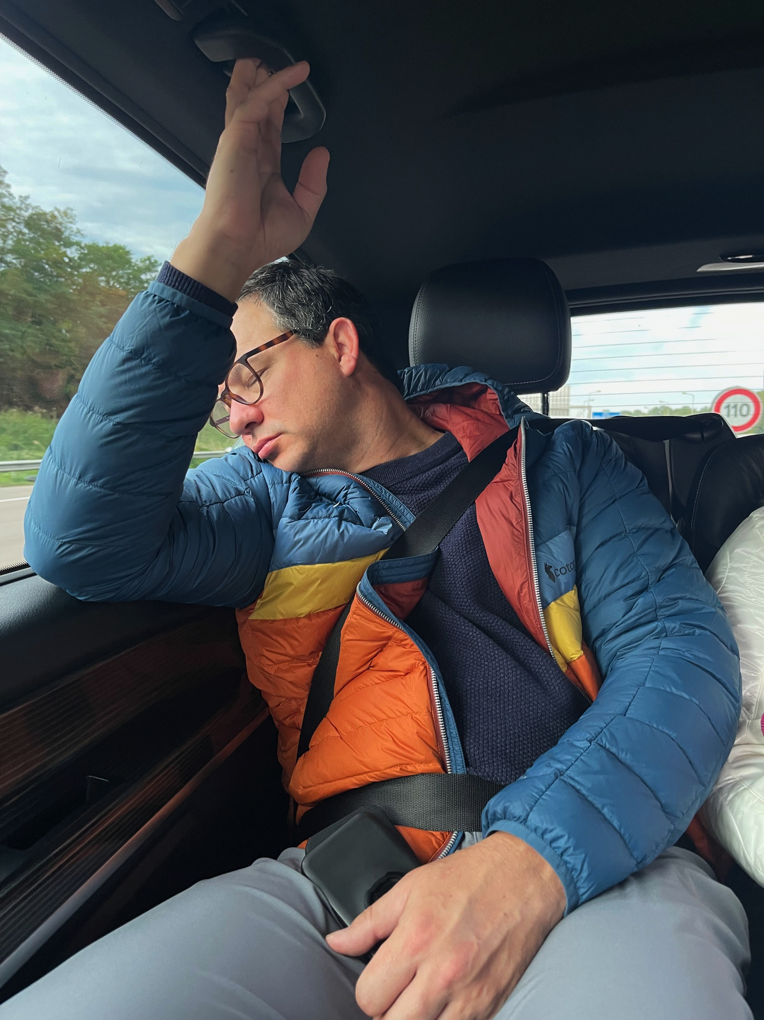
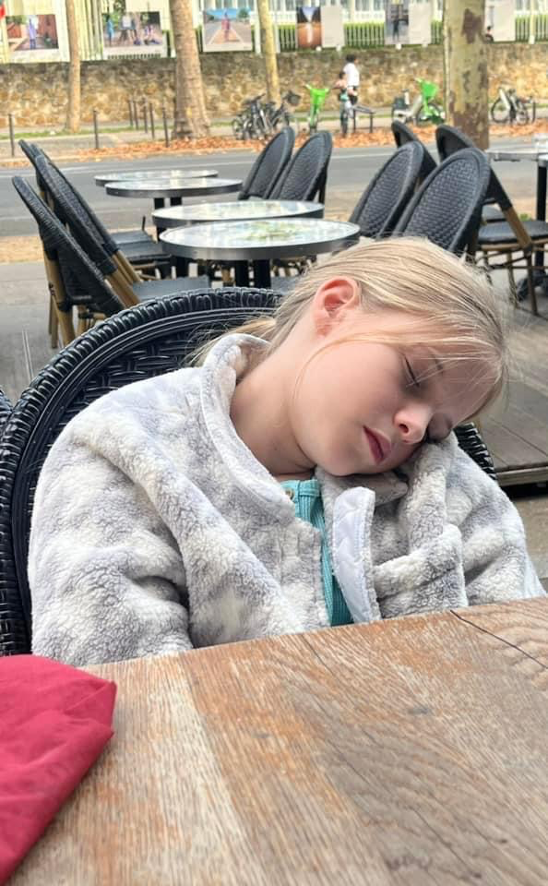
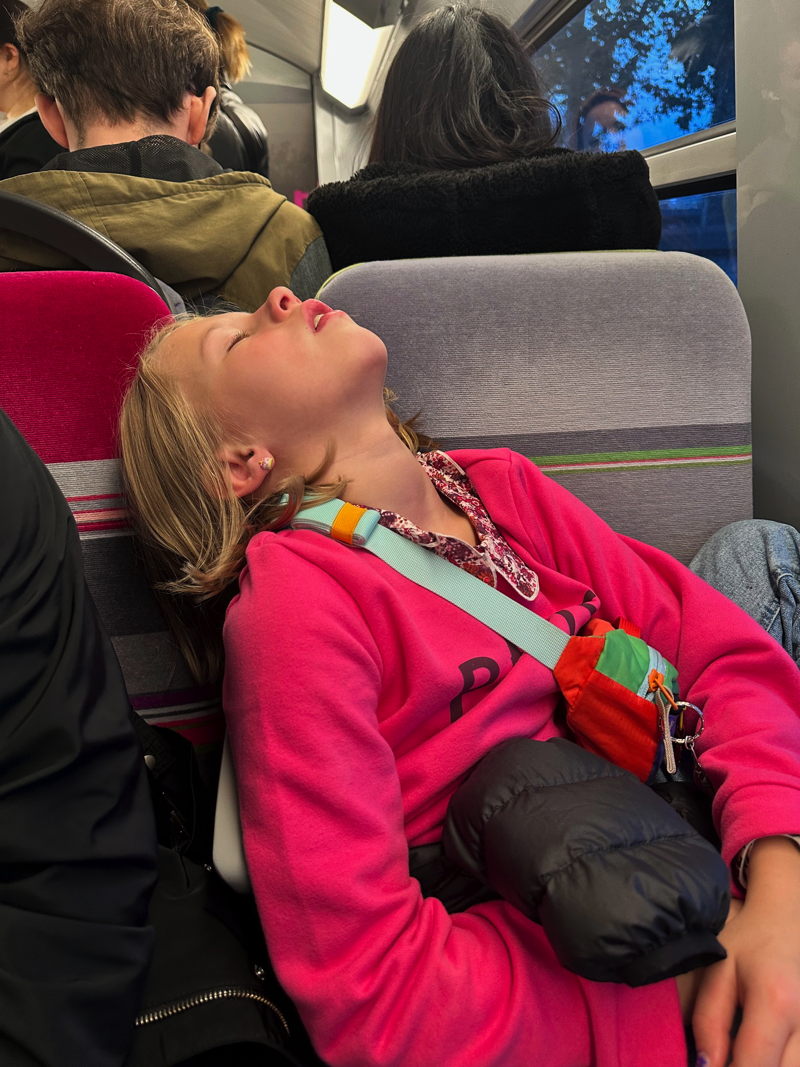
Who is this lady?
Graduated University of Kansas
Works in Healthcare
My Family
Twice.
Only.
Tolerates My Ideas.
And Oklahoma State
Once.

Slide 4
Gulf Coast Division Overview

Slide 5
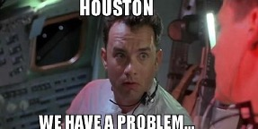
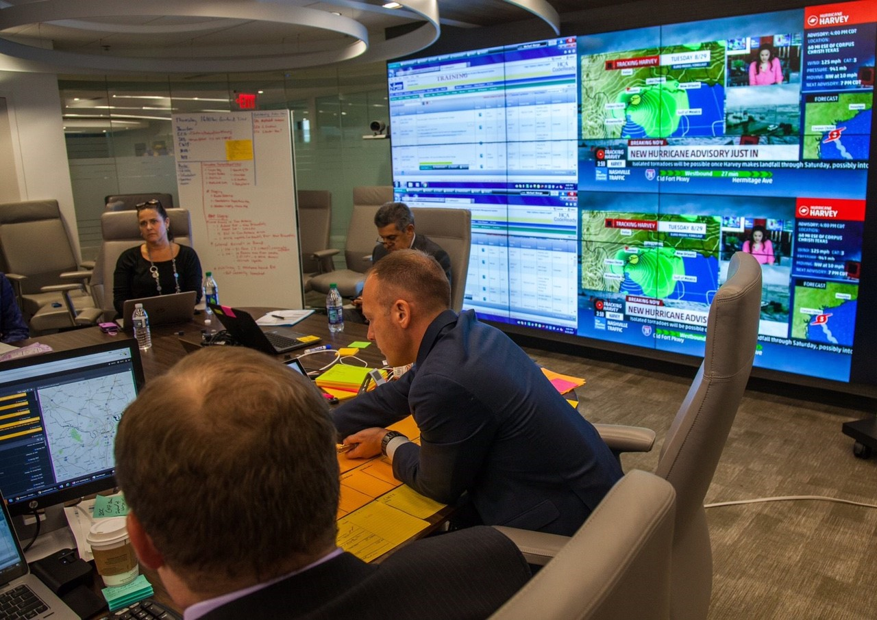
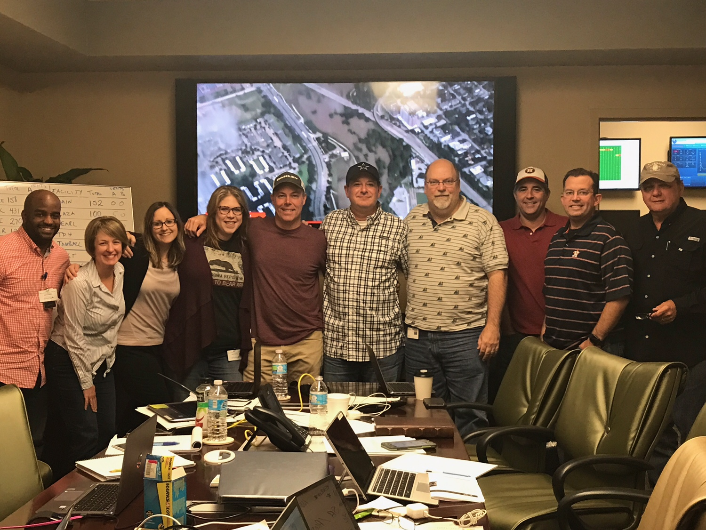
Hurricane Harvey-August 2017

Slide 6
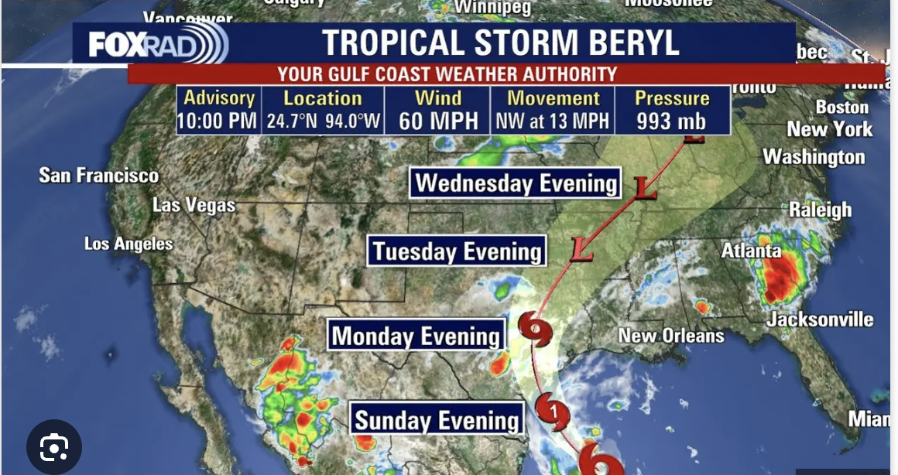
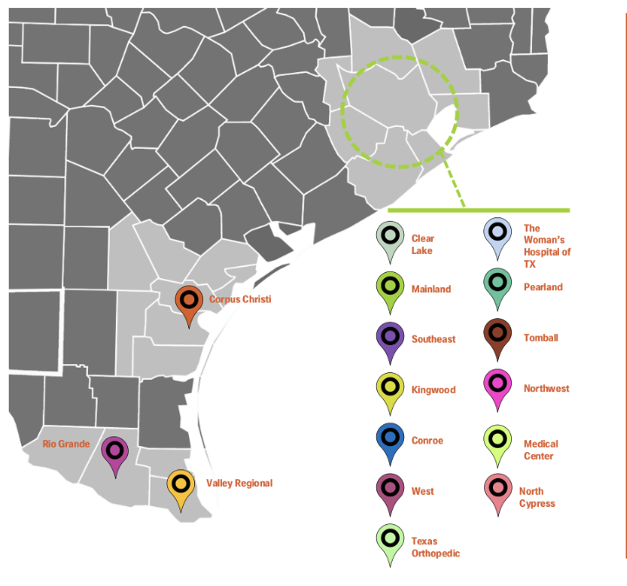
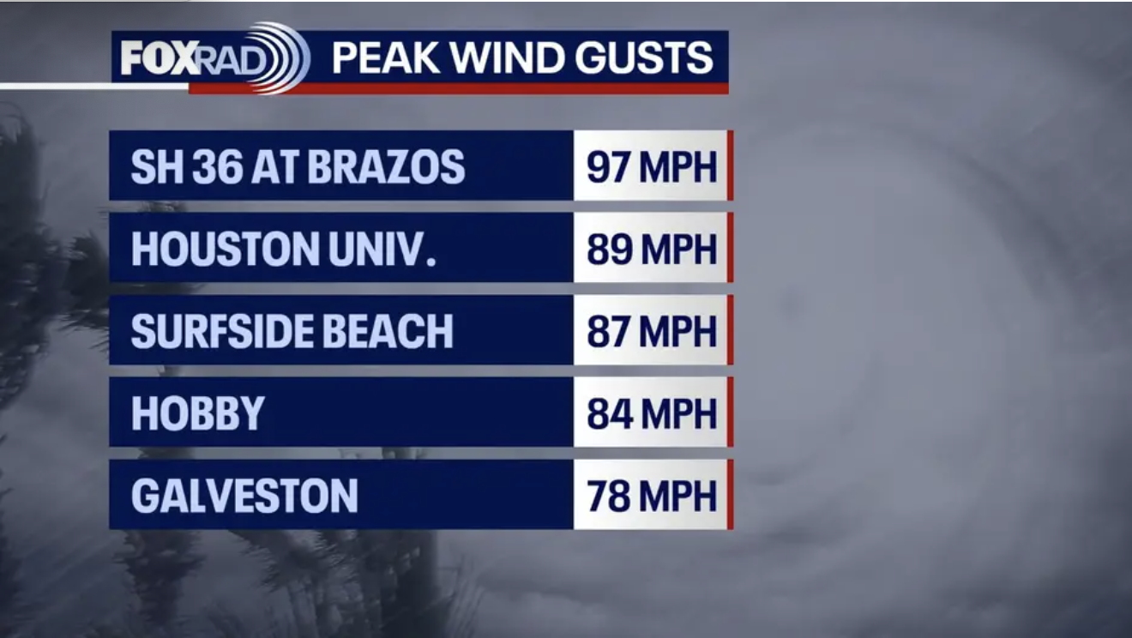

Slide 7
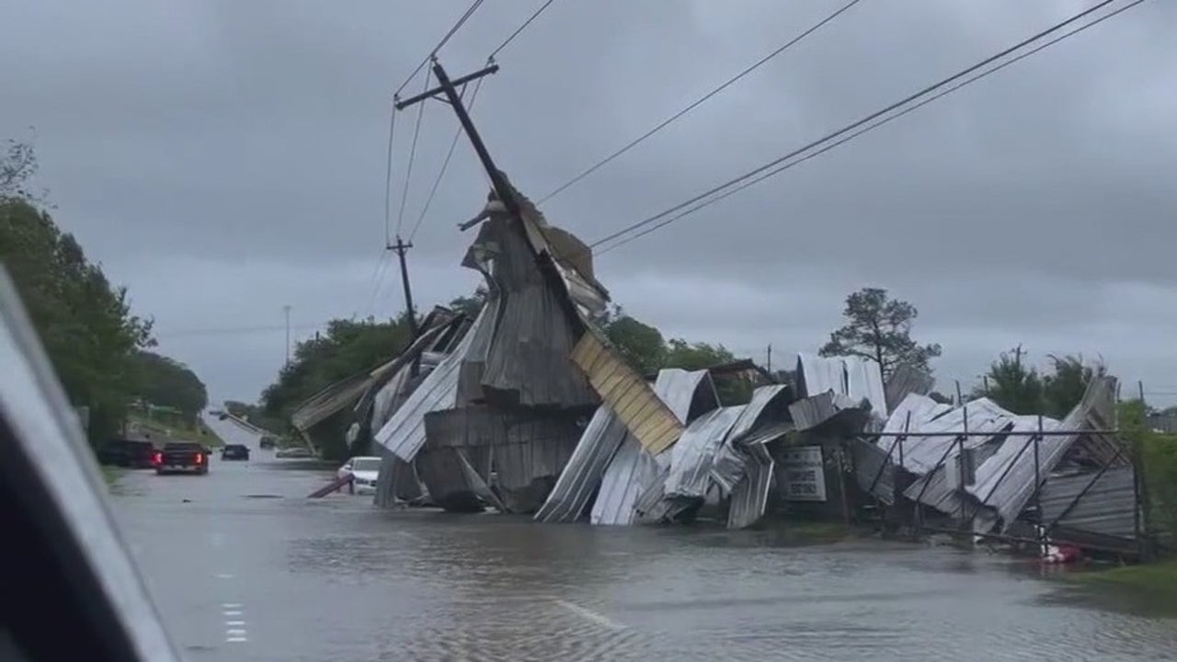
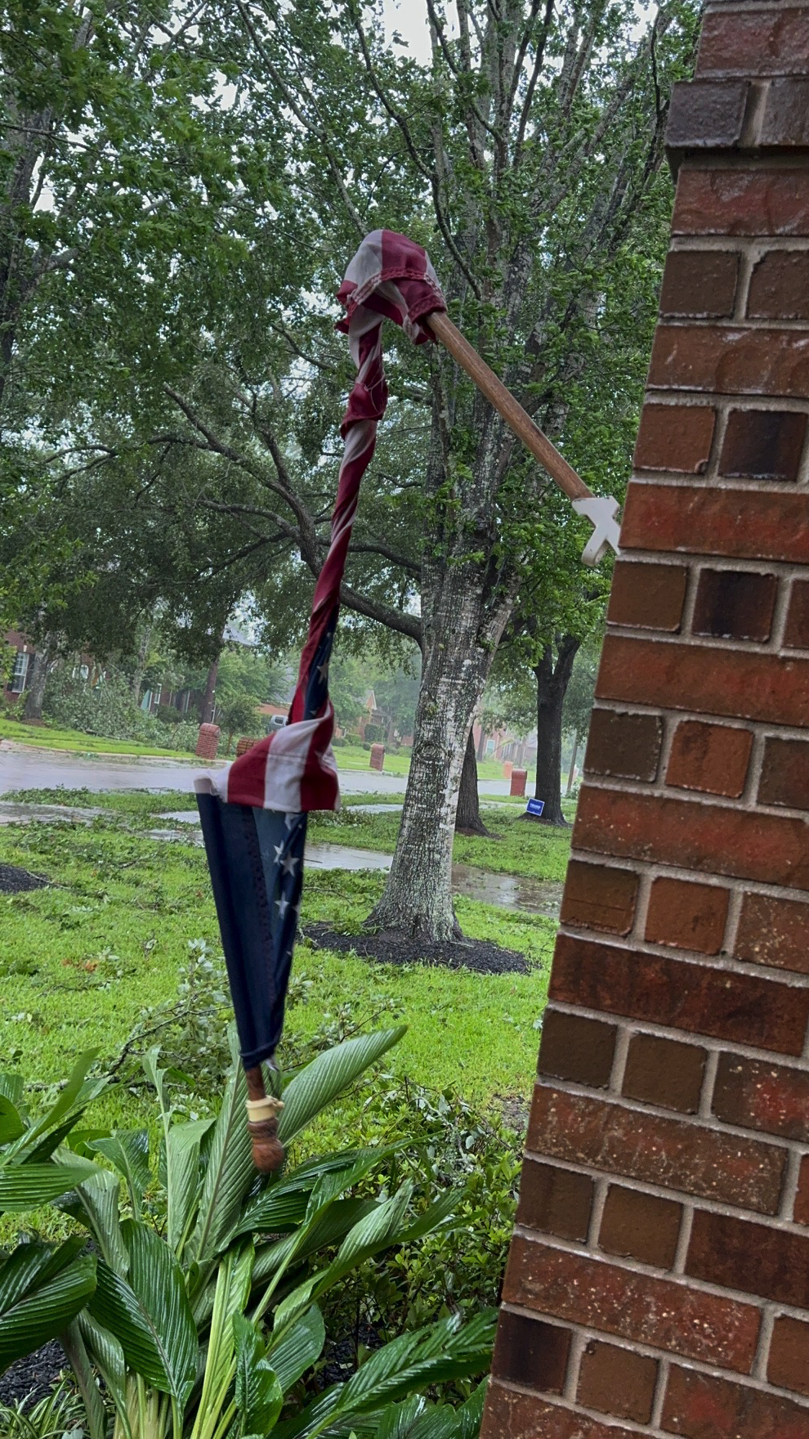
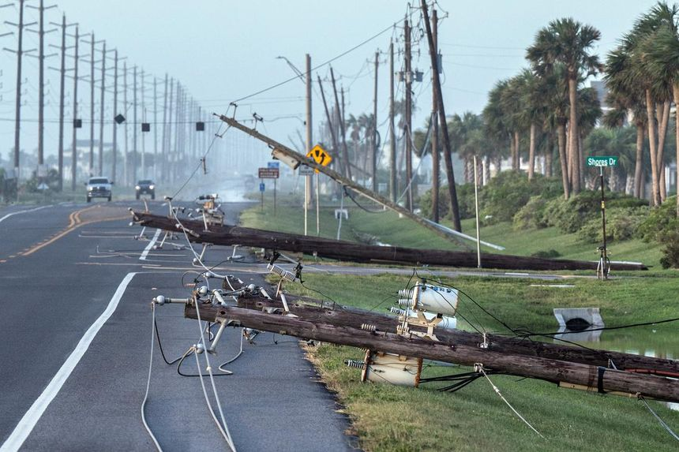
Hurricane Beryl- July 2024

Slide 8
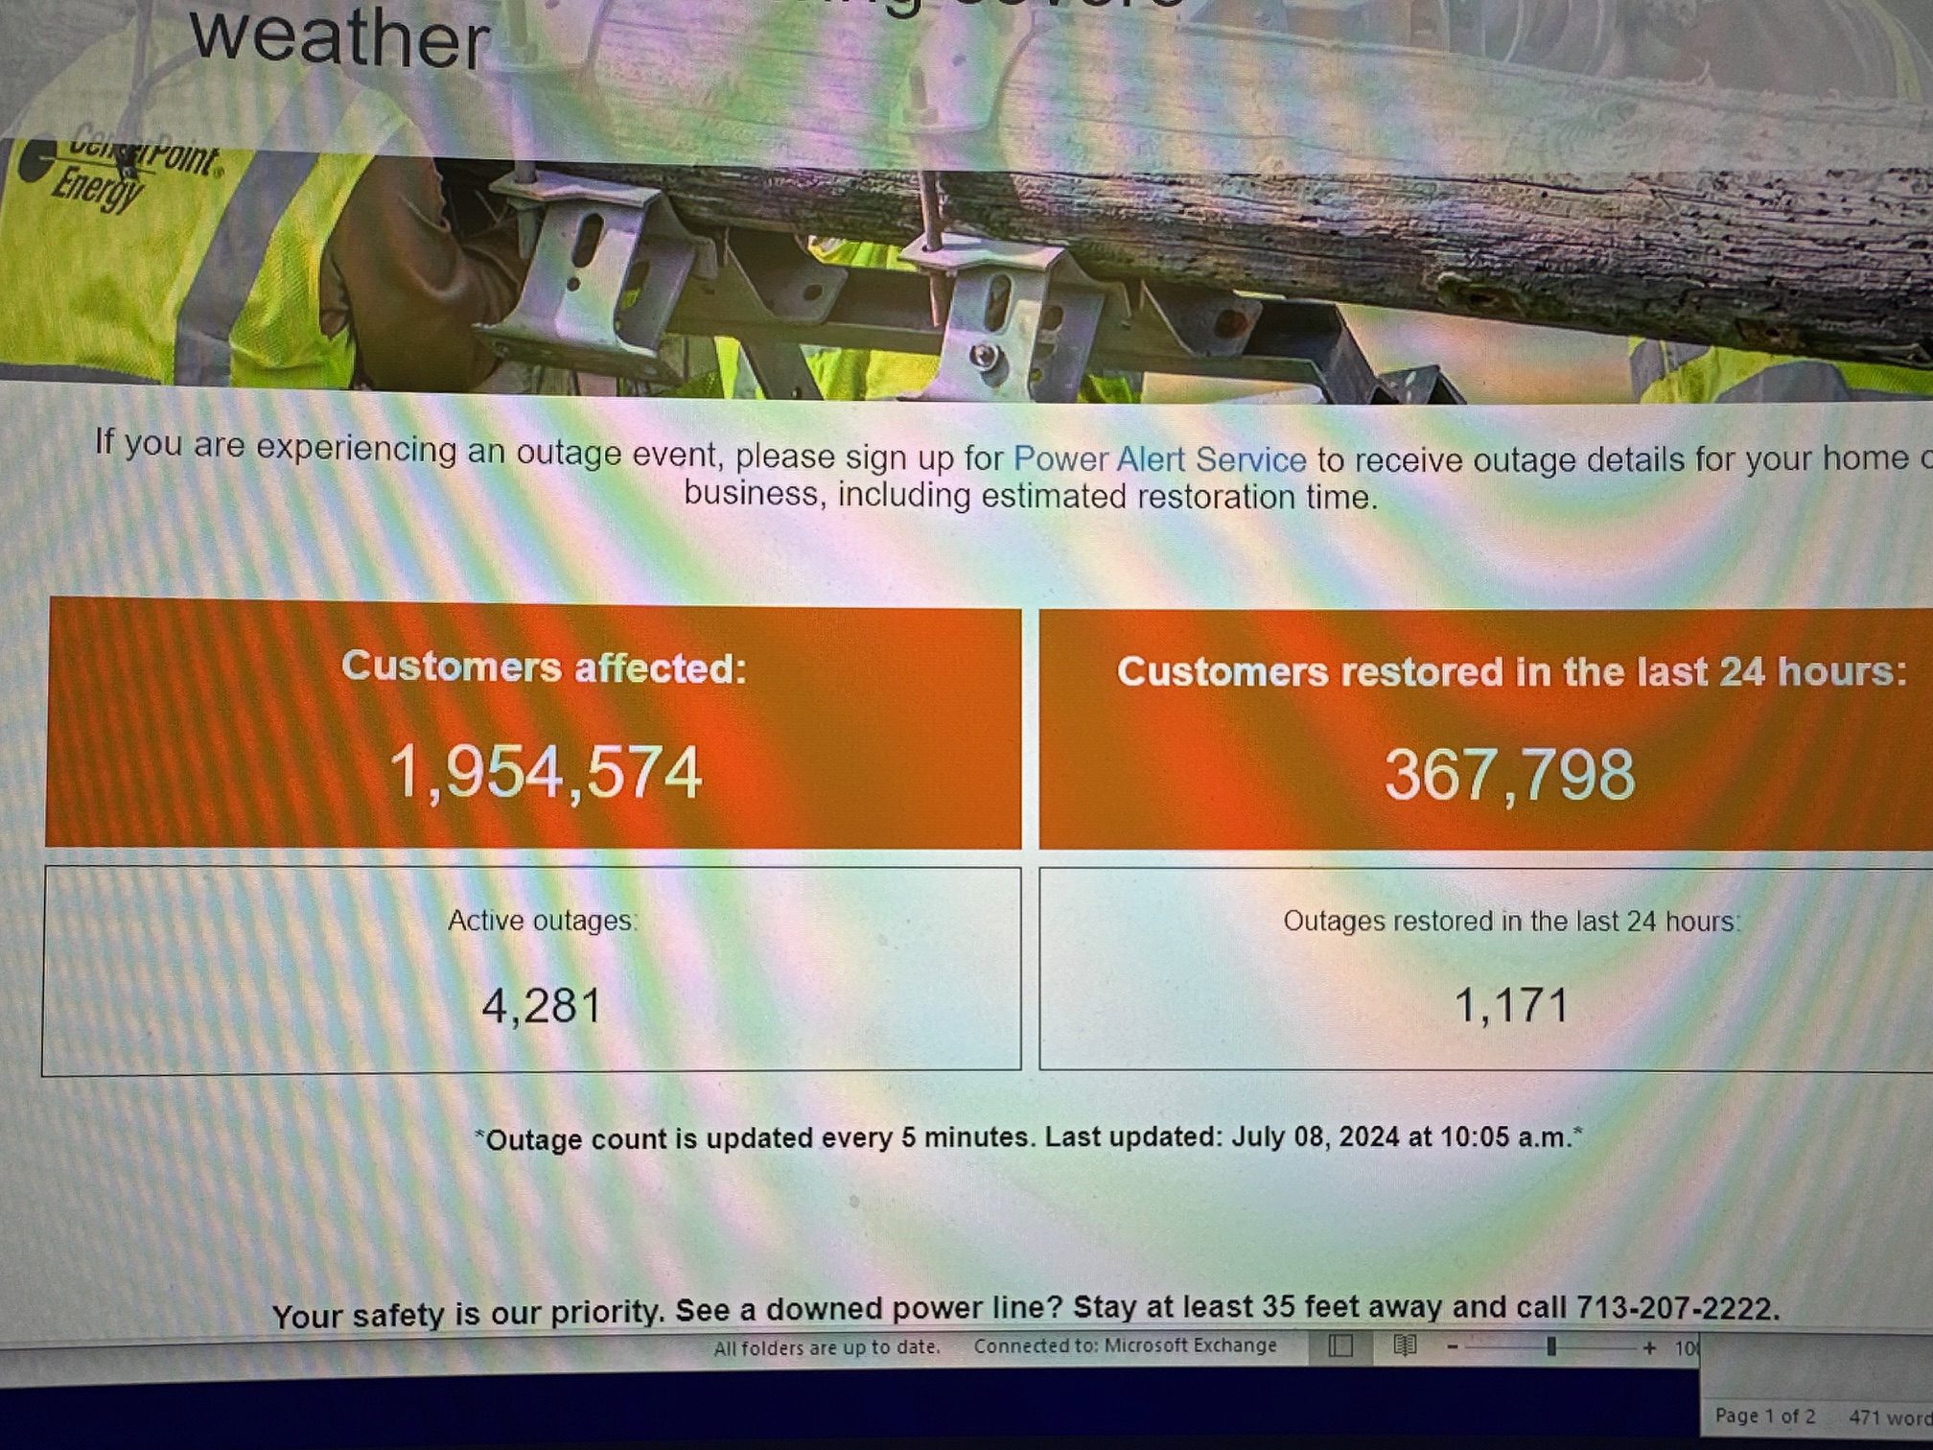
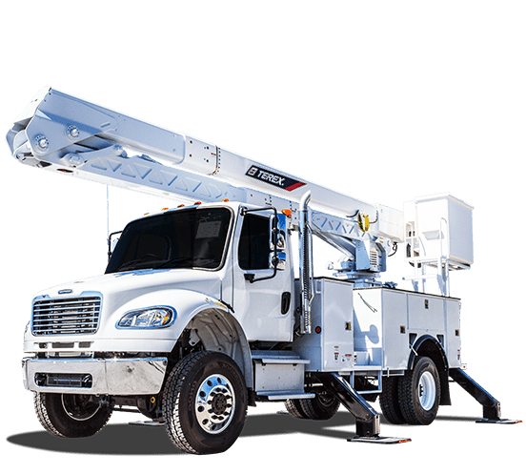
The real villain…

Slide 9
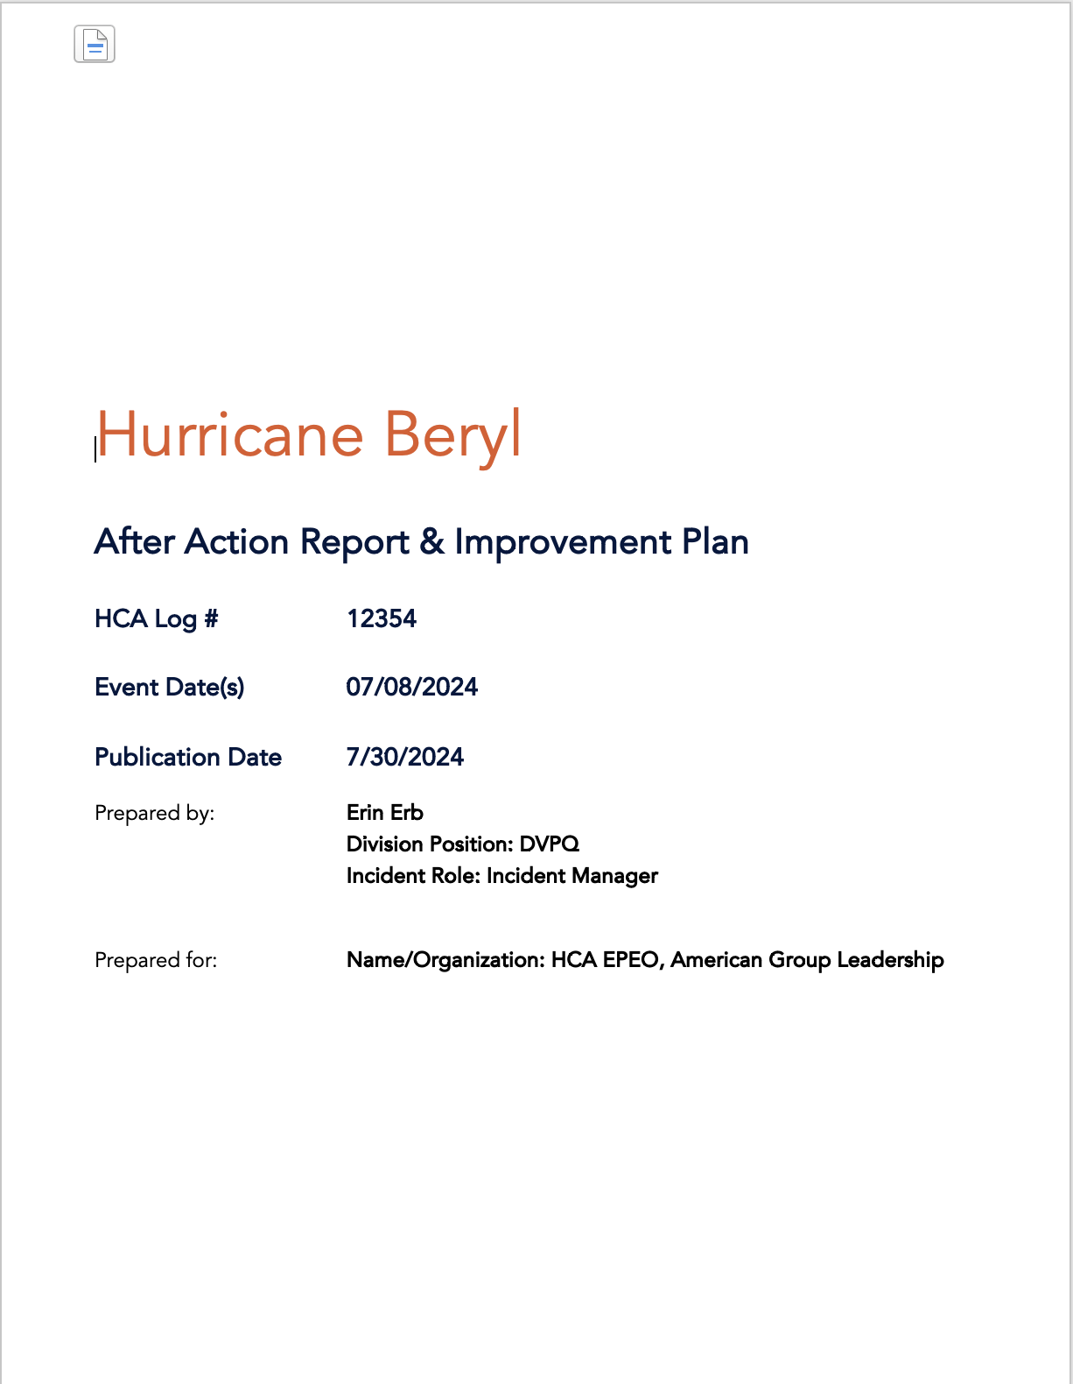
After Action Report

Slide 10
A and B Team Staffing Lockdown Triggers
Things we would do differently #1
Have a policy…and a dollar amount
Thoughtful Messaging
Know the Cost
12-hour Increments
KNOW Your Policy Deets!
Race against your neighbors
Market Hospitals?
Consistent Across the System
Triggers
Storm Category
Storm Radius
Expected Wind Impact?

Slide 11
Incident Command Virtual Vs In-Person
Things we would do differently #2
Establish Triggers for In-Person
Distance from Impact (within 60 miles of the storm)
Set Timeframe to Decide
Incident Command Selection
Elevation?
Generator Power
Sleep/Shower Rooms
A/V
Phone

Slide 12
Patient Surge Safety Assessment Continued...
Things we would do differently #3
The community
CHF
COPD
ESRD
Hungry
Displaced
The Place with the Light On!
The Emergency Room
The Lobby
The Free-Standing ER
The Waiting Rooms
Services
Electricity
Water
Heat or A/C
Dialysis
Oxygen Bar!

Slide 13
Patient Surge Safety Assessment
Things we would do differently #3.5
Disaster Protocol/Risk Level
ER Holds
ER Census
Hospital Type
Procedural Volume
Dialysis Patient Volume
Nearby Facility Status
Establish a ‘score’
Risk Level Responses
Stop Elective Procedures
Utilize OP staff in the IP/ER
Transfer Closure
Alternate Sites of Care
Dialysis Protocol and Patient Tracking
Manual Counting
Heat or A/C
Dialysis

Slide 14
Dialysis Surge and Response
Things we would do differently #4
Early Collaboration
Community Partners
Health System Coordination
Disaster Protocols
*NOT* Normal Operations
Evidence Based
Decision based on Data

Slide 15
Free Standing Emergency Room Utilization
Things we would do differently #5
EMS Engagement
Utilize FSERs to Manage Surge
FSER Physical Footprint
De Novo Vs. Acquired

Slide 16
Things we did well!

Slide 17
Things we did well!

Slide 18
Incident Commander
Facility President, Selected Facility Senior Leader
= Function usually fulfilled by Corporate or Division
EPEO Division Liaison
Incident Manager
(if necessary)
Facility EM Leader, Selected Facility Senior Leader
Clinical
Infrastructure
Support
Admin
Intel
Primary Lead
Primary Lead
Primary Lead
Primary Lead
Primary Lead
Secondary Lead
Secondary Lead
Secondary Lead
Secondary Lead
Secondary Lead
Tertiary Lead
Tertiary Lead
Tertiary Lead
Tertiary Lead
Tertiary Lead
Clinical Services
Engineering
Supply Chain
Human Resources
Current Situation Monitoring
Medical Staff / GME
IT&S
Ancillary Depts
Finance
External Liaisons / HCC
Patient Safety
Clinical Applications
Infection Prevention
Communications
Public Safety Liaison
Bed Management
Cyber Defense
Physical Security
Quality / Regulatory / Risk
Data Analytics
Transfer Center
FacilitiGroup
Business Continuity
Ethics & Compliance
Code Ready
Medical Transport
Design / Construction
Parallon / Workforce Solutions
Govt Relations / Legal
Weather / StormGEO
CMO, CNO, VP of Trauma or Emergency Services, Senior Clinical Leader
DFM, ITG Leadership, VP of Operations
COO, VP of Operations, Supply Chain Leadership, CFO
VPHR, CFO, ECO, Marketing, VPQ
Emergency Mgt Leader, EMS / Public Safety Liaisons

Slide 19
Thank you!

